Slide 1
RELIGIOUS IDENTITY AND CATEGORISATION OF THE OTHER: A sorting study of Northern Irish Identities
Tony Coxon
(Universities of Cardiff & Edinburgh)
Data from Dr Adrian Stringer,
Moneymore, Co. Derry)
___________________________________________________
This talk (Identity and Categorisation-TCD. ppt ) is downloadable from www.methodofsorting.com

Slide 2
Identity and Categorisation NI
In the Province of Northern Ireland, Social identities are strongly overlapping:
Political (Unionist, Republicanism),
Social (Class, Organizations, Gender) and
Religious ([Roman] Catholic, Protestant (Cof I, other)
Often thought of as a simple religious polarisation (e.g. religion as an ethnic marker), but actually a more complex pattern.
A recent study by Stringer investigated social networks and in/out group membership based on a range of religious denominations
Using a heterogeneous set of identities, organizations and affiliations
And using a free-sorting task to allow relevant categories to emerge & their inter-relatiopns to be investigated.
Notes:
Abstract:
Political, social and religious identities are strongly overlapping in the
Province of Northern Ireland, and are often thought of as a simple
polarisation. But the detail of activities, friendships and social networks
show a more complex pattern.
A study based on a range of religious denominations by Stringer used a
heterogeneous set of identities, organizations and affiliations in a
free-sorting task to allow relevant categories to emerge.
Keywords: Free-sorting, Multidimensional scaling, Points of view

Slide 3
Identity and Categorisation NI
The resulting sortings data also
illustrate extreme forms of categorisation
But still show significant differences.
By including questions on "See yourself as” for the Identities, it revealed relevance of the concept of reference groups to the explanatory account.
The use (and some shortcomings) of the method of free-sorting (Coxon 1999)are well illustrated by these data and their analysis.

Slide 4
Identity and Categorisation NI
2: LOCATION, CONGREGATIONS & SUBJECTS
ANONYMITY: Real locations, Modified Congregation names, Subject nos.
LOCATION: Province of Northern Ireland
CONGREGATIONS:
[Code] [Denom.] [Name]
M Church of Ireland (Anglican) St Matthias
J Roman Catholic St John & St Trea
C Independent Evangelical Christchurch
B Baha’i
(n.b. Presbyterian refusal: local Minister of the Presbyterian Church of Ireland, the largest local congregation, refused to collaborate, insisting that his Church members would be unwilling to co-operate.
SUBJECTS:
Between 10 & 12 congregants selected by gatekeepers. (see notes). Identified by number and congregational code.
N= 46:
M=10, J=11, C=12, B = 13,
Notes:
The Baha'is of Northern Ireland settled across the Province in the 1970's and '80's. There is no single place of worship. Instead members meet in one another's homes, especially for the Nineteenth Day Feast when those who have made The Declaration come together for a meal, worship and discussion.
ChristChurch Independent Evangelical Church are the product of a break-away from the Brethren congregation at The Crescent church in Belfast ten years ago. It currently meets for worship in the Octagon Suite of the King's Hall in Belfast.
St John and St Trea is a Roman Catholic parish in the RC diocese of Armagh. It is located in the Mid-Ulster village of Moneymore. Although the building and Presbytery are modern the parish has roots which stretch back to the Plantation and beyond.
St Matthias Ballyeglish is a rural parish in the Church of Ireland diocese of Armagh. It is positioned some five miles outside of the village of Moneymore. Its roots only reach back to the building of the present church in the mid nineteenth century.
SAMPLING SUBJECTS
'Mitchell writes of the important role of ‘gatekeepers’ (Mitchell, 2006:151), as does Adriance (1995:169). Both note the dependency upon such gatekeepers in providing people with whom to study, even if that is only to lead on to others through a snowballing technique (Mitchell, 2006:151). Random sampling techniques may be preferable for the purposes of generalisation, but under such circumstances (Adriance 1995:170) are not always possible – being dependent upon the gatekeeper’s selection of interviewee in the light of the researcher’s guidelines. This was certainly the case with the Baha’i and ChristChurch respondents where the gatekeepers of both communities listened to my appeal for a cross section of their memberships and then provided me with a telephone list of people to contact. The Roman Catholic Priest gave his blessing to my research, saying that I could communicate this support to whoever I approached. Sadly, he nevertheless felt that he could not give any names or addresses – with the exception of J1. The reasons for this decision are unknown, my assumption being that he may have felt it was sharing too much information with someone from a different (and in the eyes of some), opposing tradition. Such resistance was felt by Mitchell (2006) when she, as a Protestant in Northern Ireland, also tried to interview those from the Roman Catholic tradition.
This meant that I was not in a position to ask for names and addresses of those who would broadly represent the parish list as a whole. Consequently, once J1 had been visited, the remainder of the interviewees were selected by snowballing (as Mitchell, 2006) – one interviewee suggesting another whom I could visit.
The Ballyeglish sample, however - as this was my own congregation - I was able to select carefully in order to match with the general profile I had already created of that congregation.']

Slide 5
Identity and Categorisation NI
“Objects” (Identification Groups/labels)
Conventionally, objects refer to a single domain (or disjoint domains). These 27cover a range of domains:
Domains:
Nationality-- Political-- Denomination Specific -- Denom/ Faith General—
Gender-- Religious Marked Affiliation -- Class -- Intimacy Marker (1)
See following …………….
Notes:
Here is inserted the Tobjs file/table

Slide 6
CARD NAMES | DOMAINS
 | Ethnic / Nationality | Political Party | Denominl. Congregation | Faith Group | Gender | Partisan Voluntary Group | Social Class | Family marker
1. Irish | 1
2. Scottish | 1
3. Irish Scots | 1
4. Ulster person | 1
5. Unionist |  | 1
6. British | 1
7. Republican |  | 1
8. Middle Eastern | 1
9. Northern Irish | 1
10. Christchurch Independ. |  |  | 1
11. Baha'i Community of NI |  |  | 1
12. Ballyeglish CofI |  |  | 1
13. St John & St Trea RC |  |  | 1
14. Baha'i |  |  |  | 1
*15. Christian |  |  |  | 1
16. Protestant |  |  |  | 1
17. Roman Catholic |  |  |  | 1
18. Church of Ireland |  |  |  | 1
*19. Male |  |  |  |  | 1
*20. Female |  |  |  |  | 1
21. Hibernians Supp. |  |  |  |  |  | 1
22. Orange Lodge Supp. |  |  |  |  |  | 1
*23. Upper Working Class |  |  |  |  |  |  | 1
*24. Lower Middle Class |  |  |  |  |  |  | 1
*25. Working Class |  |  |  |  |  |  | 1
*26. Middle Class |  |  |  |  |  |  | 1
*27. Belonging to my Family |  |  |  |  |  |  |  | 1
Notes:
NB Starred Card Names were removed from the set subsequent to initial analysis to form “Reduced Set”

Slide 7
Identity and Categorisation NI
DATA COLLECTION
A: Free-sorting [Coxon, 1999]
N=46 (N* =44 with 2 exclusions see below)
p = 27 (FULL); = 19 (REDUCED)
(See Data in accompanying Table 1)
No constraint on # of groups
Sorting Characteristics:
DEN. RANGE #LUMPERS AVE # GPS
Baha’i 1 – 14 (13) 1 5.2
C (IndEv) 1 – 23 (22) 1 10.5
J (RC) 2 – 13 (11) 0 6.4
M (CofI) 2 – 15 (13) 0 6.5
TOTAL 1 – 23 (22) 2 7.2
B: Belonging and Ordering Identities :
how they see/identify themselves: [do/ don’t /uncertain about]
Then rank items in their positive identification pile. This enabled some indication about what identification/s were most important and the place of religion within their identities.
Notes:
Objects removed (post-collection) because
-- The heterogeneity is interesting, because it becomes clear that subjects treat some subsets differently to others, and some [male, female] are more like "instances" than component parts of their clusters. The core is obviously religious/church, political affiliations and organizations.
--objects like the class titles and gender titles were not treated in the same way, but rather as a separate exercise. A lot of people simply put the class terminogy in a separate pile, and many did the same with male/female. In some cases they were used as indicators/descriptors/ illustrations of "that group", it is true.
-- More clear is that "belonging to my family" was used as a marker of "our" identity. Each group located it firmly in the centre of their own key identity/groups,
For this reason, the whole exercise was re-run excluding 8 objects:
-- the 4 class terms,
-- 2 gender terms and
-- "family" and also
-- "Christian" as this was also used in a generic and not a differentiating way. THEN things became MUCH clearer!
First, respondents freely sorted the cards into as many piles as they liked according to what they saw as groups of identities. This enabled issues such as whether Protestants and Catholics acknowledge identities as separate from one another and more especially, whether religion was wrapped up in such identities or alternatively, if religion was separated from such identities as nationalism or unionism and therefore placed in separate piles.
-
B: Second, respondents were asked to take another set of cards (identical to the first set already used) but this time were directed to sort them into piles according to:
-- how they see themselves;
-- how they don’t see themselves; and
-- uncertainties as to whether these identities applied to them.
Third, respondents were then asked to return to the second Card Sort and this time rank their positive identification pile, so that their greatest identity was at the top, second strongest identity next and so on. This enabled some indication to be drawn from what identifications were most important and the place of religion within what respondents saw as their identities. (see Tables for data)

Slide 8
Identity and Categorisation NI
DATA ANALYSIS (D-T-M).
Data: N=44 (2 lumpers removed), p= 27(full), =19 (reduced)
Sorting data in “preferred data format” (see Table 1 et ff)
[X(i,j) gives the “own category” number (pile) into which subject i places object j ], e.g.
B1 7 7 7 5 6 1 6 7 7 4 1 4 4 1 3 3 3 3 1 5 2 2 8 8 8 8 1 (8 piles; no singletons)
Transformation: Usually ordinal -> linear (also spline)
Model/s:
Euclidean Distance (for 2D maps – context); for framework
Clustering (for categorization):
“Branch&Bound” Partition & Hierarchical Clustering for levels
Programs: The Sorting data were analyzed:
using SORTPAC www.methodofsorting.com/coxon.htm
To produce [weighted] co-occurrence matrices and dis/similarity measure/s for scaling using programs within NewMDSX package http://www.newmdsx.com/ , including:
MINI-SSA, HICLUS, BBDIAM [2W1M] and MDSORT [2W2M, Takane 1981]
Notes:
Takane, Y (1981a) Multidimensional scaling of sorting data, in Chaubey YP &
Dwivedi TD, eds Topics in Applied Statistics, Montreal: Concordia University Press,
659-666

Slide 9
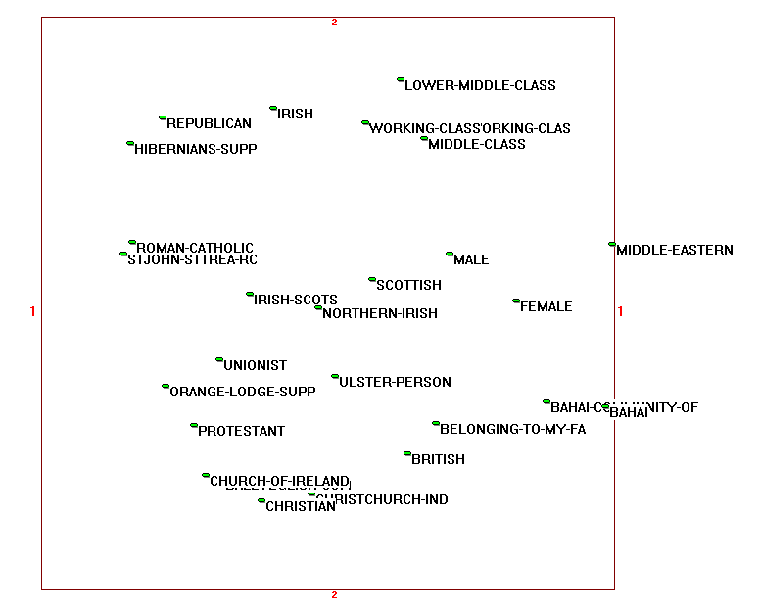
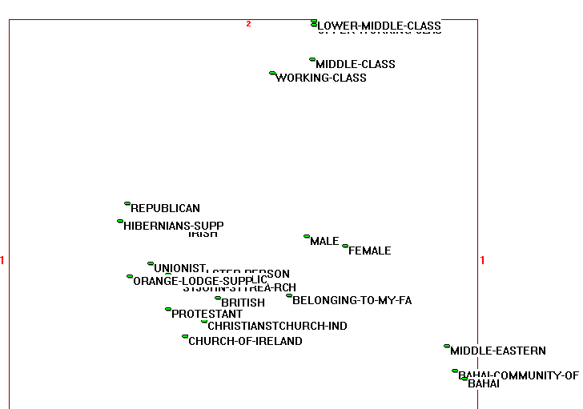
Identity and Categorisation NI
MINISSA of Co-occ 2D
MDSORT 2D Config [VReHRe]
Notes:
NOTE: (1) maps have been put into maximal procrustean conformity, consisting mainly in a double reflection
(2) program/model properties:
-- MINISSA (based on M1 – [simple] co-occurrences as proximities) and only taking into account rank-order of proximities
-- MDSORT: (Metric SVD of PM ).
“ The program generates a joint scaling by decomposing the data matrix. The major feature of the model is that a decomposition is sought which simultaneously seeks to locate both the object point locations and the category centroids for each subject - this being the degree of individual difference allowed in this model, which thus allows the subjects to be represented by a series of category centroids, rather than by a single ideal point. The intention is to obtain a configuration of stimulus/object points in such a way that the sum of squared inter-category distances (averaged over subjects) is maximized under suitable normalization restrictions” NewMDSX documentation – thus maximizing a different quantity, which explains differences in the solution.
At the macro-level, there is considerable similarity:
the maps are structurally similar, (including some VERY close pairs – of which more later); with a similar horizontal Protestant / Catholic divide; dissociated social class grouping and Baha’i group)
although MDSORT is tighter -- bigger distances between tight clumps, and MINISSA configuration is more dispersed
and semantically similar (broadly: same objects going with each other, and group/clusters relating similarly) – even puzzling links [Hib & Orange Lodge Supporters together].
At the micro-level,
considerably more differences in dispersion
some points are apparently located in different clusters or locations and/or at different distances (Unionist in MDSORT RC sector; Middle Eastern at some distance from Baha’i in MINISSA).
OUR MAIN CONCERN HOWEVER IS THE CATEGORISATION REVEALED BY THE ANALYSIS, and
GIVEN THAT MINISSA/CO-OCCURRENCE is a simpler model [and that analysis based on individual centroids -- under way -- is complex and would occupy 2 of these talks!], we’ll concentrate primarily on the Co-occurrence data.

Slide 10
Identity and Categorisation NI
Categorization & Clustering
Two variants used:
Partition Clustering (divides data-objects into a single set of n [user-specified] exclusive and exhaustive clusters , based on a dis/similarity measure). Often MacQueen’s k-means clustering is used, here Brusco 2003’s branch&bound diameter method (BBDIAM) by preference for producing best SINGLE partition (set of categories)
Hierarchical Clustering (Johnson 1967) provides set of levels from “splitter” to “lumper” partitions such that each level includes clusters present at lower (finer) levels. If solution is perfect data exhibit ultrametric inequality; otherwise two (maximum and minimum )solutions demark the two extreme possibilities. Used here for inferring higher-level bases of categories.
… and also Overlapping/additive Clustering (Arabie & Carroll 1980) – a very desirable form of analysis, but the program is not available!
Notes:
Brusco, M.J. (2003) An enhanced branch-and-bound algorithm for a partitioning problem, British Journal of Mathematical and Statistical Psychology, 56, 83-92.
BBDIAM “partitions a matrix of dissimilarities into a given number of clusters, identifying an upper bound by biased-sampling complete link cluster analysis, and then uses a branch-and-bound algorithm to minimize the 'partition diameter', that is, the maximum of the cluster 'diameters' (the maximum pairwise dissimilarity values within each group)” NewMDSX documentation.
Johnson S. C. (1967):Hierarchical clustering schemes Psychometrika, 2, 241-254
The scheme consists of a series of clustering (levels), each of which is a partition In the initial level each object forms a cluster, whilst at the highest level all the objects form a single cluster. In a hierarchical clustering scheme there are exactly (p-1) levels where there are p objects. Each intermediate level joins points or clusters present at the lower (finer) level.
Arabie P, Carroll J D (1980) How to Use MAPCLUS, a Computer Program for Fitting the ADCLUS Model, New Jersey: Bell Laboratories

Slide 11
BBDIAM Partition Solution: FULL Co-occurrence; 5 Group solution
CLUSTER 1) National Identities
2. SCOTTISH, 3. IRISH SCOTS, 6. BRITISH, 8. MIDDLE EASTERN, 9. NORTHERN IRISH
CLUSTER 2) (Ulster) Protestant
4. ULSTER PERSON, 5. UNIONIST, 10. CHRISTCHURCH IND, 12. BALLYEGLISH COFI, 15. CHRISTIAN, 16. PROTESTANT, 18. CHURCH OF IRELAND, 22. ORANGE LODGE SUPP.
CLUSTER 3) (Irish) Roman Catholic
1. IRISH, 7. REPUBLICAN, 13. ST JOHN & ST TREA RC, 17. ROMAN CATHOLIC, 21. HIBERNIANS SUPP.
CLUSTER 4) Baha’i
11. BAHA'I COMMUNITY OF NI, 14. BAHA'I, 20. FEMALE, 27. BELONGING TO MY FAMILY
CLUSTER 5) Class
19. MALE, 23. UPPER WORKING CLASS, 24. LOWER MIDDLE CLASS, 25. WORKING CLASS, 26. MIDDLE CLASS
Notes:
These have an immediate “recognisability” & similarity to the a priori categories in slide 11. But note some interesting differences:
“Irish” serves as a constituent of the Catholic cluster, rather than as a nationality!
Hibernians and Orange are allocated to the appropriate Religious Clusters, rather than being put together
Erm, Female as Baha’i and Male as a Class term?!

Slide 12
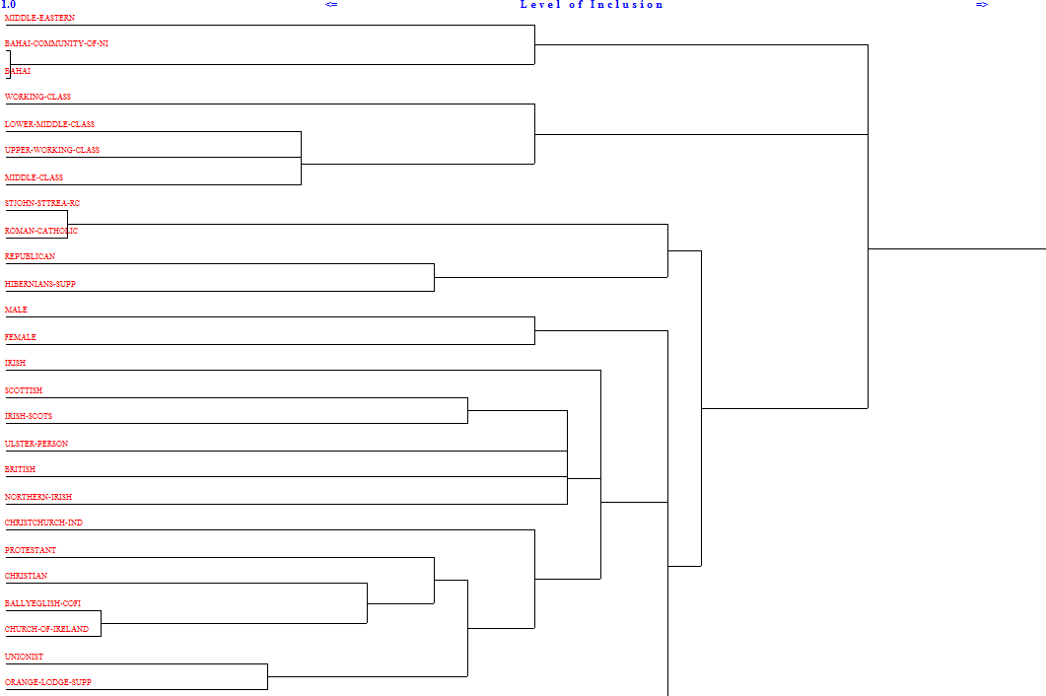
HICLUS SOLUTION FULL Co-occurrence data; Connectedness Method
Notes:
n.b. #27 “Belong Family” is off btm!
In both Cpnn & Diam solutions, there is a clear fissiparous “chaining” structure:
The stages in clustering typically consist of
Pairing, preliminary pairs which form the core (and exemplars) of later wider groups. These are typically followed by
Chaining – adding new members to an existing group, and finally
Joining – merging of already existing clusters.
Notice that “27. Belonging to my family” joins very late – a very tenuous addition.
Working from the top of dendogram (at lowest
The Baha’i are separated from all other groups at the most fundamental level
Class terminology also remains fairly disjoint , as does gender
The main cluster is a combination of Nationality and Protestant Religion
The RC Religion remains an early-formed tight cluster, merging only with Republican-Hibernian toward the end.

Slide 13
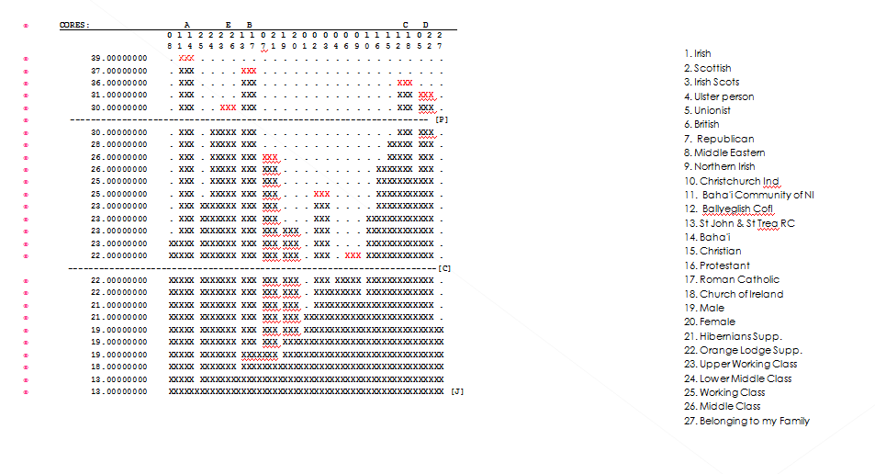
HCS-Conn. Clustering / 2

Slide 14
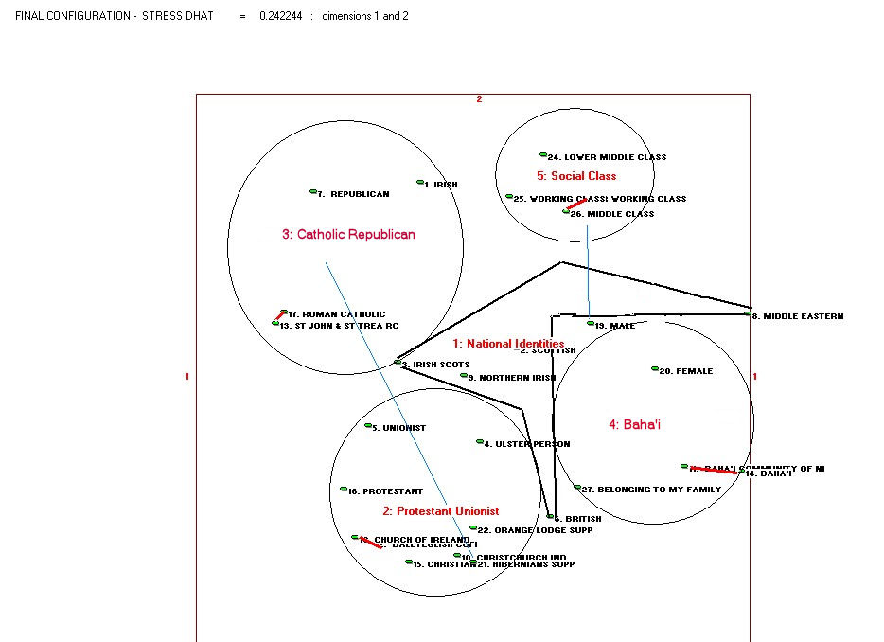
FULL INTERPRETATION!
Co-occurrence Data, SSA 2D solution,
interpreted with BBDIAM clusters and HCS cores/exemplars, and re-locations
Notes:
The answer to the NI Universe of Identities!!
(produced with NewMDSX & its graphics, and sweat and tears!)
BASIC CONFIGURATION:
2D MINISSA solution of co-occurrence data, reasonably good fit (Spence random stress [0.287] > obtained [0.242] )
Added information represented:
From BBDIAM. The 5 clusters of the partition ( 4 represented by Circle/ellipse and one “1: National Identities” by its “convex hull”) labelled in red.
elements “wrongly” located in SSA map re-allocated by blue line (e.g. Hibernian from Protestant into Catholic clusters!)
From HICLUS. The cores (first pair joined to become basis for larger cluster), interpretable as “exemplars” of the category.
BUT NOW >>>>>>>>>>>>
There is a lot of information so far that an analysis of the total, full, group may well contain and mask important group (rather than individual) differences, and before we can really interpret what is going on here in terms of Identities it is instructive to look at the four denominational subgroups and the similarities & differences.
SO, NOW … (1) we reduce the objects (starred on Slide 6) and (2) analyse within groups.

Slide 15
Identity and Categorisation NI
It becomes obvious that
it is the four congregational/affil. groups that are the primary meaningful units and they each have different (often contradictory) patterns of identity.
So, analyze WITHIN each of the 4 religious groups
Objects like the class titles and gender titles were not treated in the same way as the other objects (though they were often used as illustrations of "that group”
A lot of people simply put the four class terminology cards in a separate pile, and many did the same with male/female cards
So, remove Class and Gender Identities them from subsequent analysis
The card “27. belonging to my family" was typically used as a marker of "our" identity. Each group located it firmly in the centre of their own key identity/groups.
So, remove it also from subsequent analysis
Although “Christian” was in some cases appropriated to their own primary group, usually it was used generically, or as a singleton
So, remove it also from subsequent analysis (for scaling at any rate!)
The resulting 27-8 = 19 objects are now retained (“REDUCED set” – see Slide 6)
The “SEE YOURSELF/DON’T SEE YOURSELF “ data (table 2) and subsequent ranking of their own identity are also used to clarify matters.
Notes:
SO >>>>>>>>>>>>>>>>>>
There is a lot of information that an analysis of the total, full, group may well contain and mask important group (rather than individual) differences, and before we can really interpret what is going on here in terms of Identities it is instructive to look at the four denominational subgroups separately and at their similarities & differences, and reduce the number of objects.

Slide 16
Identity and Categorisation NI
Patterns of Identity and “Negative Identity”
The “See-as” data provide useful evidence of different points of view of identity, viewed from each denominational perspective
Quite remarkably, there is (IMHO) a staggering degree of unanimity or consensus within the four groups:
not only on “who I am/we are”,
but also of “who I/we are NOT”.
In effect, these are positive and negative Reference Groups, in Merton’s terminology.
Typically, each Congregational group identifies one or two tight positive ref.gp cluster (the "us") and then (usually) between 2 and 4 out-groups that act as their negative reference.
First, a general overview of the patterns of consensus, and then each group in turn with its pattern and its scaled configuration (from MDSORT)

Slide 17
Identity and Categorisation NI
Basic Data are :
(Table 2): Set of the 27 identity items sorted in terms of:
”See myself as belonging to X…” into 3 fixed response categories : Agree/Disagree/Unsure.
(Table 3): Subject s then were asked to rank their “agree group” items
Because Ss differ in size of Agree group/pile they form, restricted for analysis to their top five in terms of ordering, to keep comparability .
Research Questions:
(1) How far are members agreed within their community in terms of POSITIVE identification ?
In some cases there was (almost, or total ) unanimity of agreement (coded yellow ). The entries are their rank letter.
(1) How far are members agreed within their community in terms of NEGATIVE identification ?
Here there are typically 9 or 10 objects which are unanimously (or almost) rejected for identification (coded purple) in each community – a significant fact!
Further analysis can take two forms:
What pattern of Pos/Neg identification characterise each community (and whether they are reciprocated!)
For each item/object, which communities claim or disavow them.

Slide 18
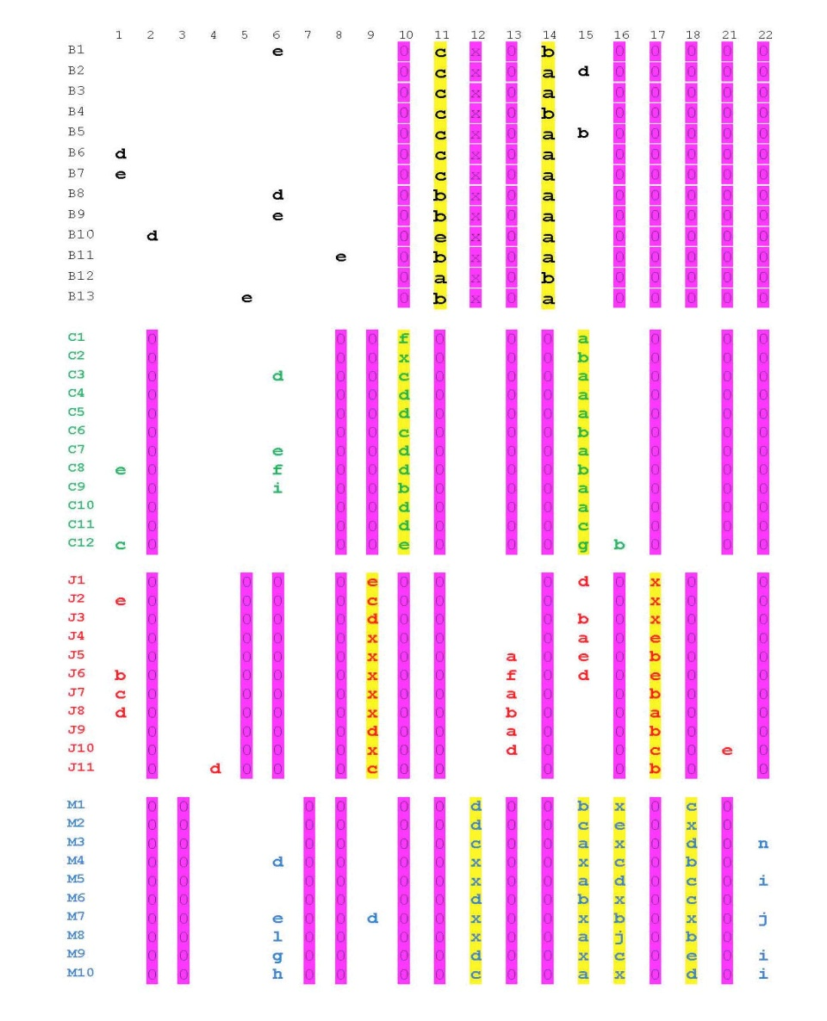
Patterns of Consensus: 4 DenomS
ITEMS (top cols):
1. Irish 2. Scottish 3. Irish Scots 4. Ulster person 5. Unionist 6. British 7. Republican
8. Middle Eastern 9. Northern Irish 10. Christchurch Ind Ev. 11. Baha'i Commty. of NI 12. Ballyeglish CofI 13. St John & St Trea RC 14. Baha'i 15. Christian 16. Protestant
17. Roman Catholic 18. Church of Ireland 21. Hibernians Supp. 22. Orange Lodge Supp.
BLOCKS: B: BAHA’I C: EV.INDEP J: RC M: CofI
Notes:
I was struck by how much unanimity (or near-unanimity) there was within each congregational community in terms of “objects” selected to reflect “see myself as”
Interested in how far members agreed within their community with: POSITIVE identification (1 of Table 2).
In some cases there was (almost, or total ) unanimity. These are coded yellow (the entries are their rank letter).
Usually a community agrees totally in terms of its own denomination (and church, where present) – 2 core pos. groups in all but CofI, which have four (additionally: Christian and Protestant)
NEGATIVE identification ( non-1 of Table 2 … tho’ “disagree” could have been used.
Here there are typically 9 or 10 objects which are unanimously (or almost) rejected for identification in each community – a significant fact!
The further analysis can be two ways:
What pattern of Pos/Neg identification characterise each community
For each object, which communities claim or disavow them.

Slide 19
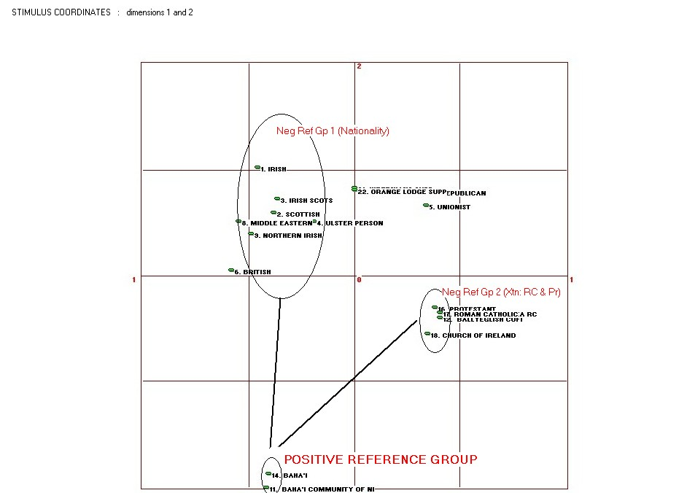
BAHA’I
MDSORT
IDENTIFICATION
 | 1 | 2 | 3 | 4 | 5 | 6 | 7 | 8 | 9 | 10 | 11 | 12 | 13 | 14 | 15 | 16 | 17 | 18 | 21 | 22
B1 |  |  |  |  |  | e |  |  |  | 0 | c | x | 0 | b |  | 0 | 0 | 0 | 0 | 0
B2 |  |  |  |  |  |  |  |  |  | 0 | c | x | 0 | a | d | 0 | 0 | 0 | 0 | 0
B3 |  |  |  |  |  |  |  |  |  | 0 | c | x | 0 | a |  | 0 | 0 | 0 | 0 | 0
B4 |  |  |  |  |  |  |  |  |  | 0 | c | x | 0 | b |  | 0 | 0 | 0 | 0 | 0
B5 |  |  |  |  |  |  |  |  |  | 0 | c | x | 0 | a | b | 0 | 0 | 0 | 0 | 0
B6 | d |  |  |  |  |  |  |  |  | 0 | c | x | 0 | a |  | 0 | 0 | 0 | 0 | 0
B7 | e |  |  |  |  |  |  |  |  | 0 | c | x | 0 | a |  | 0 | 0 | 0 | 0 | 0
B8 |  |  |  |  |  | d |  |  |  | 0 | b | x | 0 | a |  | 0 | 0 | 0 | 0 | 0
B9 |  |  |  |  |  | e |  |  |  | 0 | b | x | 0 | a |  | 0 | 0 | 0 | 0 | 0
B10 |  | d |  |  |  |  |  |  |  | 0 | e | x | 0 | a |  | 0 | 0 | 0 | 0 | 0
B11 |  |  |  |  |  |  |  | e |  | 0 | b | x | 0 | a |  | 0 | 0 | 0 | 0 | 0
B12 |  |  |  |  |  |  |  |  |  | 0 | a | x | 0 | b |  | 0 | 0 | 0 | 0 | 0
B13 |  |  |  |  | e |  |  |  |  | 0 | b | x | 0 | a |  | 0 | 0 | 0 | 0 | 0
Notes:
BAHA’I:
POS: Two Baha’I objects: BAHA’I and BAHA’I Cty of NI
NEG: Christian DENOMINATIONS (but NOT “Christian” itself). RC, CofI, XtCh-Ev – but also “Protestant”
NB: National ID does not feature, and despite it being attributed to them, they do not “own” “Middle Eastern”

Slide 20
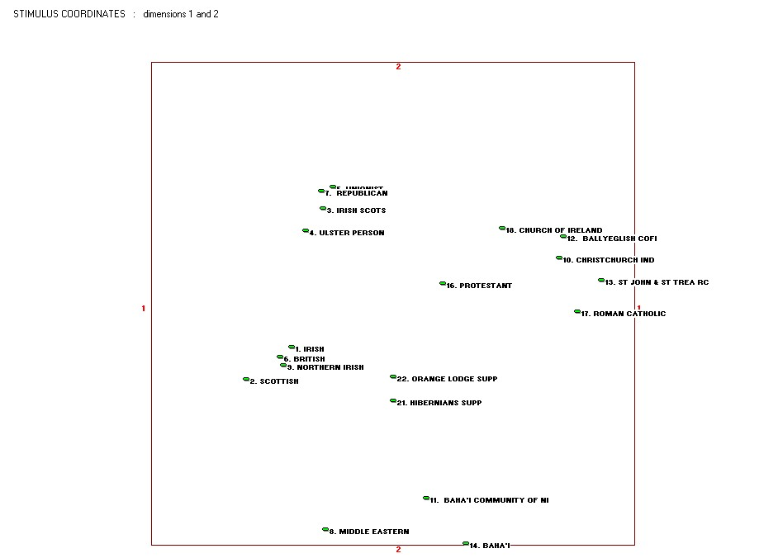
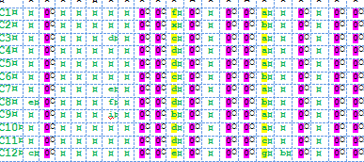
CHRISTCHURCH INDEP. EVANGELICAL
MDSORT
identification
Notes:
NB: CONFIGURATION is badly fit and in some ways incoherent
Positive ID: Their own congregation … and “Christian” (& Family)
Negative: Nationalities: Scottish, Middle Eastern, Northern Irish, Irish-Scots
Religion: Baha’i (2), RC (3, inc Hibernian, Republican), … and Orange??!
HRISTCHURCH INDEPENDENT EVANGELICAL;

Slide 21
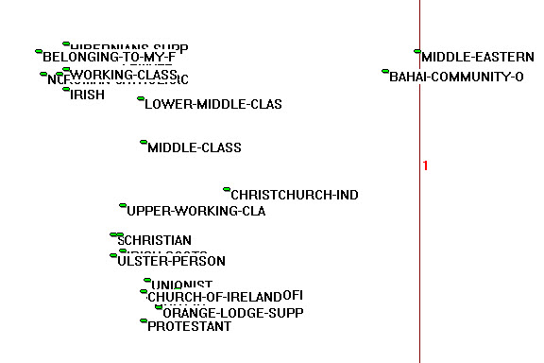
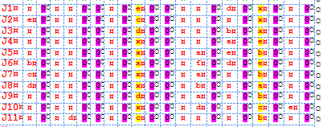
Roman Catholic
MDSORT
Identification
Notes:
St JOHN RC
Positive:
RC, Republican …
Negative:
Nationalities: British, Scottish, Middle Eastern, Northern Irish (=Prot)
Religions: Baha’i …. But also “Protestant” and denoms: Evangelical, CofI,
Political: Unionist.
NB very simple MDS structure – almost 1-dimensional

Slide 22
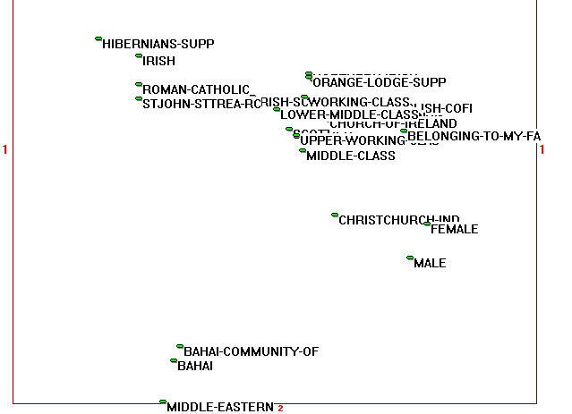
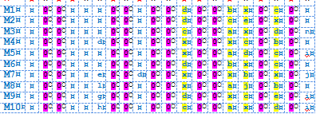
Church of Ireland (Anglican)
MDSORT
Identification
Notes:
Positive:
FOUR!! CofI & St Matthias CofI; but also “Christian” and Protestant: Guardians of the key identities!
Negative (similar to RCs):
Nationalities: Scottish, Irish Scots (?Presbyterians), M/Eastern
Religions: RC (all), Evan., and Baha’I (nb Christchurch allocated closer to Baha’I region! – into outer darkness?!

Slide 23
Identity and Categorisation NI
So what? Some Conclusions & Results
Similarity, difference and belonging are central concepts to this account. Despite common perception, bipolarisation is (grossly) inadequate representation
several groups and bases & contexts for judgment;
mediation via 3rd groups, and (multiple) positive & negative
belonging is better seen as evaluation on perceived similarities…
But nonetheless:
Shared perspectives within religious communities, with unusual “tight” in-groups and distant out-groups
high consensus not only about boundaries but also evaluations of out-groups
Only partial symmetry/reciprocity between groups .
Almost all of these issues can in principle be approached and tackled within this methodological framework.

